Slide 1
Formal Specification of Fast Paxos in TLA+
By Gaurav Gandhi & Lim Ngian Xin Terry

Slide 2

What’s the need of Consensus?
Value 1
?
Value 2

Slide 3



An Analogy
?

Slide 4
Paxos Overview
Roles:
Coordinator: Moves the protocol forward when conflict occurs.
Proposer: Proposes a value.
Acceptor: Votes on a value to be chosen.
Learner: Acts as the replication factor for the protocol.
Phases
Prepare (P1a): “Prepare to receive a proposal from me.”
Promise (P1b): “I promise to ignore anyone before you.”
Accept (P2a): “Please accept this value I am proposing.”
Accepted (P2b): “I accept the value you proposed.”

Slide 5
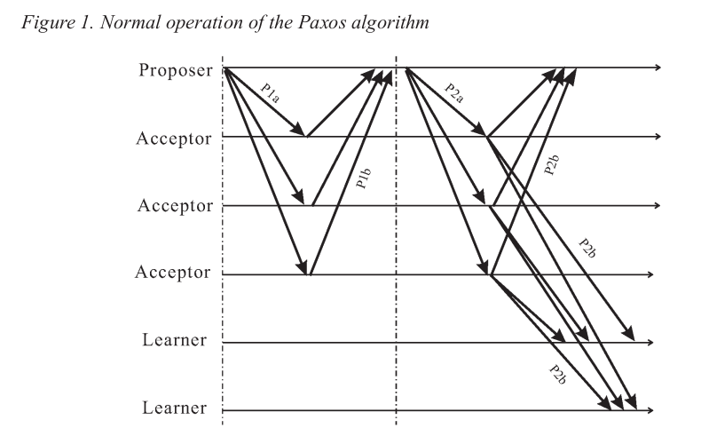
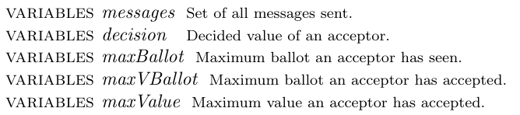
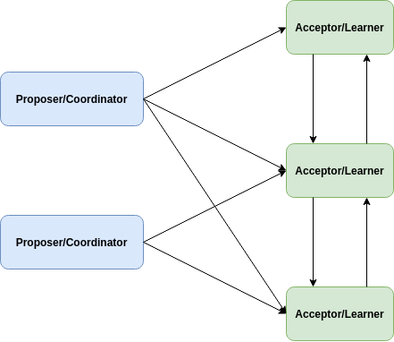
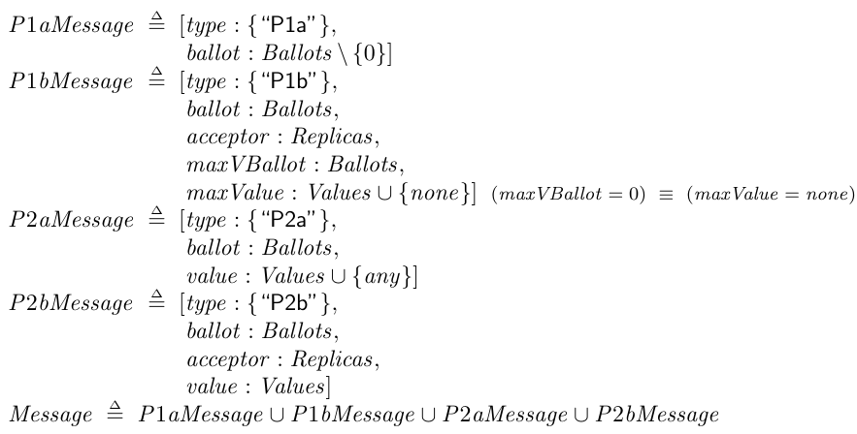
Our Classic Paxos Model
2 explicit roles: Proposer & Acceptor
Proposers are also Coordinators.
Acceptors are also Learners.
Quorum = n/2 + 1, where n is the number of
acceptors.
All nodes in the system can communicate with one
another.

Slide 6
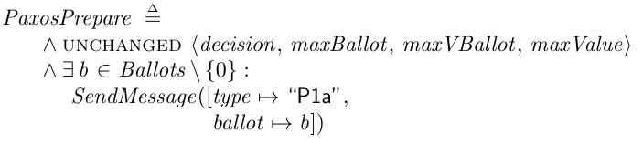
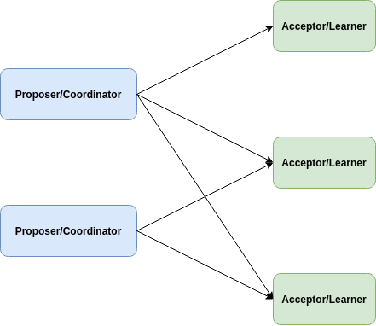
Prepare Phase (P1a)
Proposer broadcasts a Prepare (P1a)
message.
Message only contains ballot number.
Message doesn’t contain Proposer. Why?
  Possible for 2 Proposers to use the same
  ballot number for Prepare (P1a) message.
  Impossible for more than 1 Proposer
  to receive a majority of Promise (P1b) replies.
  Unnecessary to explicitly model which
  Proposer the message is from.
Messages can be sent in random ballot order.
  System is asynchronous. A message may be delayed,
  dropped or received out of order.

Slide 7
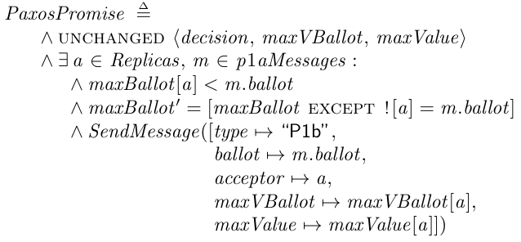
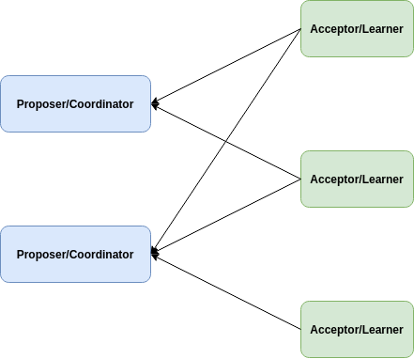
Promise Phase (P1b)
If an Acceptor a receives a Prepare (P1a)
message m such that
maxBallot[a] < m.ballot, reply with a
Promise (P1b) message.
If Acceptor had already sent an Accept (P2b)
message from a smaller ballot, attach the ballot
maxVBallot[a] and value maxValue[a] to the
Promise (P1b) reply.

Slide 8
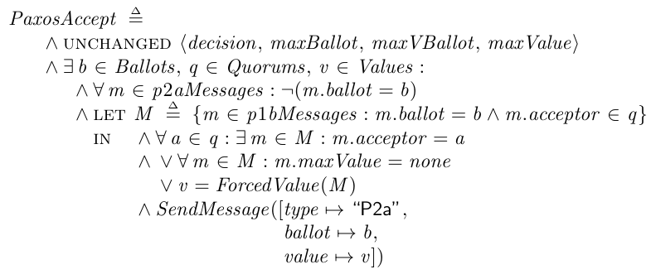
Accept Phase (P2a)
If a Proposer receives a quorum of
Promise (P1b) replies, broadcast an
Accept (P2a) message with a proposed
value v.
If all Acceptors in the quorum has not accepted
any values before, v can be anything.
Else, v is the maxValue with the highest
associated maxVBallot in received
Promise (P1b) replies.

Slide 9
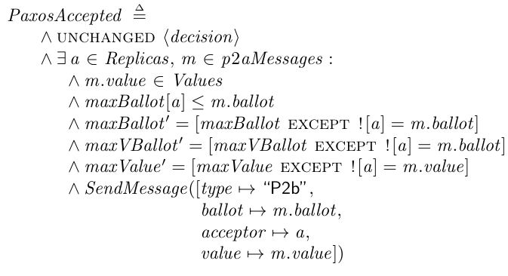
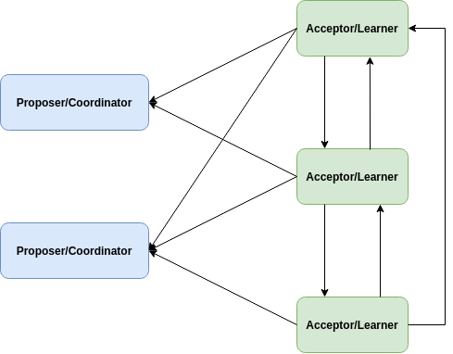
Accepted Phase (P2b)
If an Acceptor a receives an Accept (P2a)
message m such that
maxBallot[a] ≤ m.ballot, accept the
proposed value v, and broadcast an
Accepted (P2b) message with a and v
attached.

Slide 10
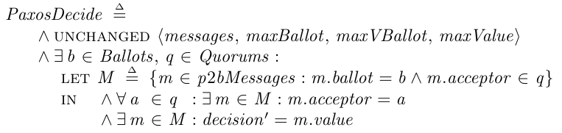
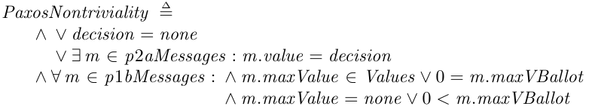
Decide (End)
If an Acceptor receives a quorum of
Accepted (P2b) messages for a ballot,
it decides on that value. The value is
said to be learnt.
Non-triviality: Only proposed values can
be learnt.
Consistency: At most 1 value can be learnt.

Slide 11
Fast Paxos Overview
New Phases
Fast Accept (P2a): “Propose and accept any value.”
Fast Accepted (P2b): “I propose and accept this value.”
Differences:
Prepare (P1a) and Promise (P1b) phase no longer needed.
Two possible cases:
  Case 1: No collision. In a fast quorum of acceptors, only 1 value was proposed/accepted.
  Case 2: Collision. In a fast quorum of acceptors, more than 1 value was proposed/accepted.
When no collision, faster than classic Paxos.
When collision, fall back to using Classic Paxos.

Slide 12
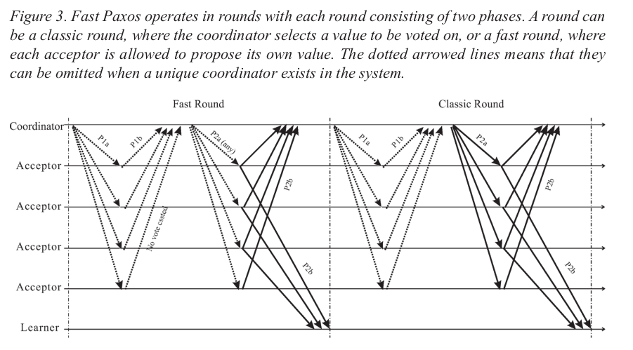
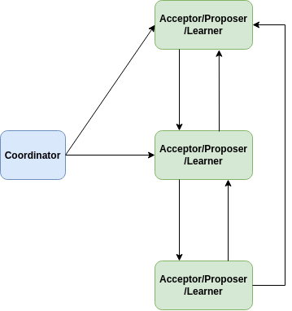
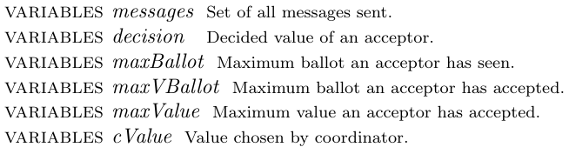
Our Fast Paxos Model
2 explicit roles: Coordinator & Acceptors.
There is only 1 Coordinator.
Acceptors are also Proposers and Learners.
Same messages as Classic Paxos.
No Prepare (P1a) & Promise (P1b) phase.
Fast Quorum = 3n/4, where n is the number of acceptors.

Slide 13
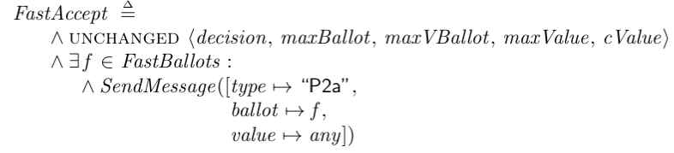
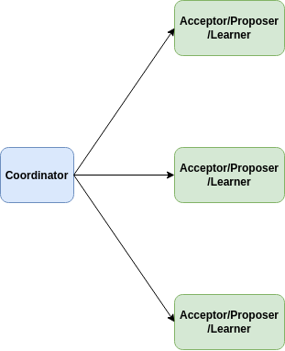
Fast Accept Phase (P2a)
Coordinator initiates a fast round if there
are currently no proposed values, by
sending an Fast Accept (P2a) “any”
message to Acceptors.

Slide 14
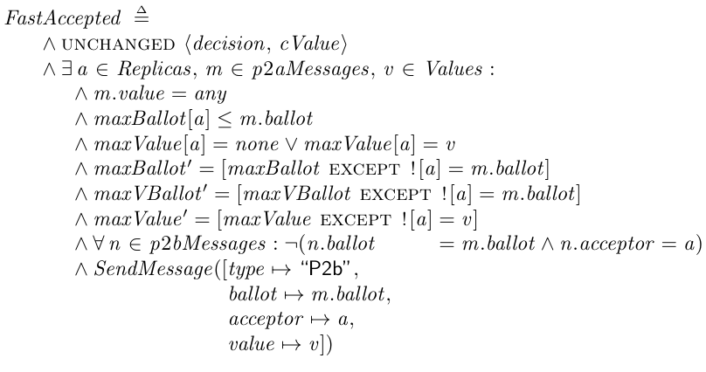
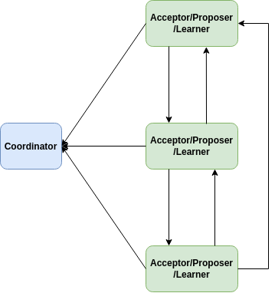
Fast Accepted Phase (P2b)
If an Acceptor a receives an Fast Accept
(P2a) message m such that
maxBallot[a] ≤ m.ballot, it will propose
a value v, and broadcast a Fast Accepted
(P2b) message with a and v attached.

Slide 15
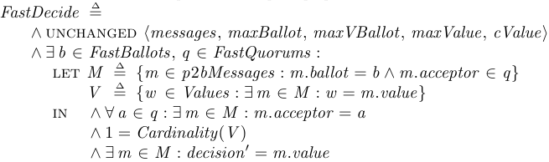
Fast Decide (No Collision)
If an Acceptor receives a fast quorum of
Fast Accepted (P2b) messages for a
ballot of a fast round, and every message,
proposes the same value v, it decides on v.
The value v is said to be learnt.
Non-triviality: Only proposed values can be learnt.
Consistency: At most 1 value can be learnt.

Slide 16
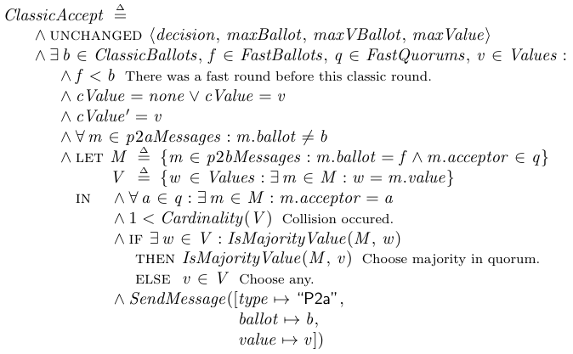
Classic Accept Phase (P2a)
For fast ballot f, a fast quorum of Fast
Accepted (P2b) messages has more than
1 proposed value.
Resolve collision via following rules:
  If the messages contain different values, a
  value v must be selected by the coordinator if
  the majority of acceptors in the fast quorum
  proposed v.
  Otherwise, the coordinator is free to select
  any value proposed.
After selecting a value v, the Coordinator
will start a classic round by sending a
Classic Accept (P2a) message with ballot b
such that f < b, and with value v.

Slide 17
Classic Accepted Phase (P2b)
If an Acceptor a receives an Accept (P2a)
message m such that
maxBallot[a] ≤ m.ballot, accept the
proposed value v, and broadcast an
Accepted (P2b) message with a and v
attached.

Slide 18
Decide (Collision)
If an Acceptor receives a quorum of
Accepted (P2b) messages for a ballot,
it decides on that value. The value is
said to be learnt.
Non-triviality: Only proposed values can
be learnt.
Consistency: At most 1 value can be learnt.

Slide 19
FLP Impossibility Theorem vs Paxos
The FLP Impossibility theorem states that in an asynchronous network where messages may be delayed but not lost, there is no consensus algorithm that is guaranteed to terminate in every execution for all starting conditions, if at least one node may experience failure.
But Paxos does not guarantee termination!

